Slide 1

Introduction to Identity and Access Management (IAM)
WSO2 Identity Server Fundamentals

Slide 2
Why Identity and Access Management (IAM)?
Securely store and manage user identities and access privileges
Ensure user identity and grant access to the right resources at the right time for the right reasons
Provide a better user experience (UX)
Enable regulatory and privacy compliances
Increases productivity and reduce IT costs
Get your app to market faster

Slide 3
Traditional Access Management

Slide 4






Managing access at the application level
In traditional web app login, authentication and account management happens within each individual application
HR
Application
User Store 1
Accounts Application
User Store 2
Sales
Application
Application User
[John Doe]
User Store 3

Slide 5
Issues with Traditional Access Management
Higher chances of data breaching
  Using simple passwords or same password for multiple applications
  Security and account management is not a cornerstone in applications
Minimum UX
  Remembering multiple login credentials is a hassle
  Login experiences might not be consistent
  Having to wait till the admin team create accounts for each application
Difficulty in governance
Less agility and low productivity
High IT cost
Difficulty in complying to regulations

Slide 6
Identity and Access Management Concepts

Slide 7

Centralized Access Management
A central system handles user authentication and account management
User Store
HR Application
Identity Provider (IdP)
WSO2 Identity Server
Accounts Application
Application User
[John Doe]
Sales Application

Slide 8
User Provisioning
Process of creating and managing user accounts and information within the system
User Store
New User John Doe [Name, Address, Email, etc.]
Create /Manage
Application User
[John Doe]
Identity Provider (IdP)
WSO2 Identity Server

Slide 9
Single Sign-On (SSO)
Authenticate users once and allow access to other associated applications
HR Application
Accounts Application
Identity Provider (IdP)
Application User
[John Doe]
WSO2 Identity Server
Sales Application

Slide 10



Multi-Factor Authentication (MFA)
Challenge users with multiple authentication factors such as password, SMS, and fingerprint
Application
Identity Provider (IdP)
Application User
[John Doe]
WSO2 Identity Server

Slide 11
Multi-Factor Authentication (MFA)
Something you know
Something you have
Something you are
Identity Provider (IdP)
WSO2 Identity Server

Slide 12

Adaptive Authentication
Challenge users with multiple authentication steps based on the users’ risk profile
If PC
Identity Provider (IdP)
WSO2 Identity Server
If mobile device
Application
Application User
[John Doe]

Slide 13



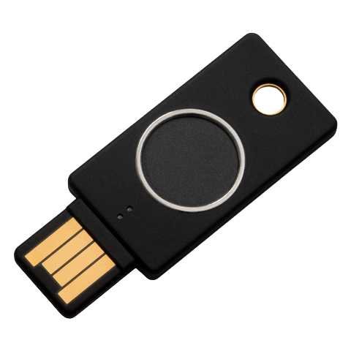
Passwordless Authentication
Authenticating users, using authentication mechanisms that does not use password such as magic link.
Application
Identity Provider (IdP)
Application User
[John Doe]
WSO2 Identity Server

Slide 14



Multi-Attribute Login
Allow multiple attributes for identification during login such as mobile number, email, and employee ID .
Application
Identity Provider (IdP)
Application User
[John Doe]
WSO2 Identity Server

Slide 15



Identity Federation
Let users bring their identities from another identity provider
External IdP
User Store
Application
Identity Provider (IdP)
Application User
[John Doe]
WSO2 Identity Server

Slide 16



Identity Federation with Social Login
Let users bring their identities from a social service provider
External IdPs
WSO2 Identity Server
User Store
User Store
User Store
Application
Identity Provider (IdP)
Application User
[John Doe]
WSO2 Identity Server

Slide 17



Business-to-Business CIAM
Manage access to your organization for business customers / partners
Admin
Admin
Admin
employee
customer
employee
customer
employee
customer
Your Organization
Partner
B2B customer 1
B2B customer 2

Slide 18




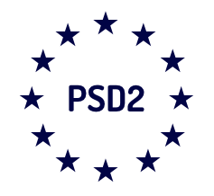
Privacy and Regulatory Compliance
Identity Provider (IdP)
WSO2 Identity Server

Slide 19
WSO2 Identity Server

Slide 20
Value Proposition
Fully open source (Apache 2.0 open source license)
Multiple deployment options:
  On-prem (WSO2 Identity Server)
  Public SaaS (Asgardeo)
  Private SaaS (IPK)
Inherent extensibility for building a tailor-made IAM platform
24*7 support for production customers

Slide 21
Value Proposition
1+ billion identities managed worldwide
280+ direct subscription customers and 1200+ OEM-driven deployments
Globally operating - main offices in USA, UK, Germany, Brazil, Australia, UAE, Malaysia and Sri Lanka

Slide 22



Industry Recognition
Overall leader and Product leader- KuppingerCole Leadership Compass on CIAM platforms - 2022/2020
Strong performer - The Forrester Wave™ on Customer Identity and Access Management - Q4 2022/2020
Leader overall - KuppingerCole Leadership Compass on Identity APIs - 2019
Product leader in LC: Access Management and Federation - 2018
Gartner Peer Insights - Rating 4.4(out of 5)

Slide 23
Key Features
Web Single Sign-On (SSO) and Identity Federation
Identity Bridging
Adaptive and Strong - Multi Factor Authentication (MFA)
Accounts Management and Identity Provisioning
Branding and Internationalization
API Access Management
B2B CIAM
Data privacy compliance
Integration with CRM, Sales, and Marketing applications
IAM developer tools

Slide 24
Key Benefits
Avoids vendor lock-in with open source and open standards
Extensible architecture allowing customization to support unique IAM use cases
Accommodates large-scale deployments with millions of users
Effortless integration with cloud and on-premises applications, third-party authentication systems, and social identity providers
Hassle-free deployment and low-cost maintenance
Flexibility to choose a preferred deployment: on-premise, public cloud, or private cloud.

Slide 25
Quick Recap

Slide 26

Traditional access management and its issues
An overview to IAM concepts and benefits
WSO2 Identity Server features and benefits
What you learnt

Slide 27



Any Questions ?
Reach us through the following channels
iam-dev@wso2.org
https://stackoverflow.com/questions/tagged/wso2-identity-server
https://discord.com/invite/Xa5VubmThw

Slide 28
Thank you!
Notes:
Acknowledge that it’s been a lot of changes within the team
Thank you for your taking onboard the feedback and being open to change.
A lot of work , a lot of learning, sometimes feeling twice the exhaustion
But also hopefully seeing what I see, which is: better ways of working, more innovation in our approach, more business acumen, more effective reactivity , more ahead of the game. Because that’s where marketing needs to be.
All this in a context where it’s also been a lot of changes for WSO2.
And from this standpoint I wanted to remind you of what Sanjiva said about you owning the culture

